Slide 1
SUPPLY CHAIN PERFORMANCE: ACHIEVING STRATEGIC FIT AND SCOPE

Slide 2
Outline
Competitive and supply chain strategies
Achieving strategic fit
Expanding strategic scope

Slide 3
COMPETITIVE AND SUPPLY CHAIN STRATEGIES
What is Competitive Strategy? How to achieve Competitive strategy?
It is defined as the long term plan of a particular company in order to gain competitive advantage over its competitors in the industry.
It is aimed at creating self-protective position in an industry and generating a superior Return on Investment.
Such type of strategies play a very important role when industry is very competitive and consumers are provided with almost similar products. One can take example of mobile phone market.

Slide 4
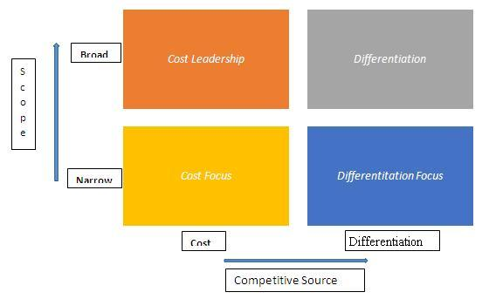
Before develop a competitive strategy, one needs to evaluate all strengths, weaknesses, opportunities, threats in the industry and then go ahead which would give one a competitive advantage.

Slide 5
Cost Leadership
The firm is to become the lowest cost producer in the industry and is achieved by producing in large scale which enables the firm to attain economies of scale.
High capacity utilization, good bargaining power, high technology implementation are some of factors necessary to achieve cost leadership.
Example: Micromax smart phones and mobile phones are giving good quality products at an affordable price which contain all the features which a premium phone like Apple or Samsung offers.

Slide 6

(Walmart logo, used from June 30, 2008-present.)
Type : Public
Industry : Retailing
Founded : 1962
Founder(s) : Sam Walton
Headquarters : Bentonville, Arkansas,US
Number of locations : 8,970 (2011)
Area served : Worldwide
Key people : Mike Duke(CEO) H. Lee Scott(Chairman) S. Robson Walton (Chairman)
Employees : Approx. 2.1 million (2011)
Subsidiaries : Walmex Asda Sam's Club Seiyu Group

Slide 7
The central goal of Wal-Mart is to keep retail prices low -- and the company has been very successful at this.
Experts estimate that Wal-Mart saves shoppers at least 15 percent on a typical cart of groceries.
Wal-Mart Stores Inc. is rolling out its "everyday low prices" (EDLP) retail strategy to more international markets to replace the more usual high-low pricing in emerging markets. EDLP means working with suppliers to ensure their prices are constantly low, but also means price changes are kept to a minimum.
Wal-Mart also employs a good structure that works with the systems to empower the low price strategy.
Wal-Mart has in place a set of systems that helps it achieve its strategy of low prices everyday.

Slide 8
Success Mantra…
Access to the capital required to make a significant investment in production assets.
Design skills for efficient manufacturing
High level of expertise in manufacturing process engineering.
Efficient distribution channels.

Slide 9
Differentiation leadership
The firm maintains unique features of its products in the market thus creating a differentiating factor.
With this differentiation leadership, firms target to achieve market leadership. And firms charge a premium price for the products (due to high value added features).
Superior brand and quality, major distribution channels, consistent promotional support etc. are the attributes of such products.
Example: BMW offers cars which are different from other car brands. BMW cars are more technologically advanced, have better features and have got personalized services

Slide 10
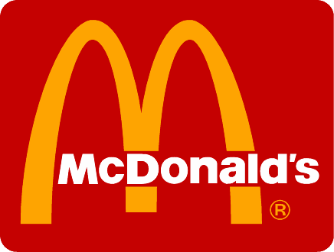
Type : Public
Industry : Restaurants
Founded : McDonald’s Corporation
~ May 15, 1940 in San Bernardino, California
~ April 15, 1955 in Des Plaines, Illinois
Founder(s) : Richard and Maurice McDonald,( McDonald’s restaurant concept )
Ray Kroc,( McDonald’s Corporation founder )
Headquarters : Oak Brook,Illinois,US
Area served : Worldwide
Key people : James A. Skinner (Chairman & CEO)

Slide 11
Number of locations : 32,000
Employees : 4,00,000 ( 2010)
Products : Fast Food
( hamburgers , chicken , french fries , soft drinks , coffee , milkshakes , salads, desserts , breakfast )
McDonald's customers are of all classes, but largely working and middle classes, and people of all ages.
McDonald’s strove to meet a customer wait time at no more than one minute in line and 30 seconds at the counter.

Slide 12
McDonald's understood that the parent was making the purchasing decision, most likely based solely on price. What McDonald's marketing executives did was ingenious. They put a $.50 toy in with the hamburger, french fries, and Coke. Then they gave it a special name, calling it a Happy Meal. Then they marketed it to the kids.
McDonald's knows that some customers go to its stores to take a quick break from their day's activities and not because McDonald's was able to make their food ten seconds faster than a competitor. So McDonald's marketing executives then put together the phrase, “Have you had your break today?”
They've taken competing on price right out of the picture,” says Greshes. “They bring you quality, convenience, service, and value — and they make you feel like you are getting a break in your hectic day.

Slide 13
Success Mantra…
Access to leading scientific research.
Highly skilled and creative product development team.
Strong sales team with the ability to successfully communicate the perceived strengths of the product.
Corporate reputation for quality and innovation.

Slide 14
Cost focus
The firm concentrates on specific market segments and keeps its products low priced in those segments.
Such strategy helps firm to satisfy sufficient consumers and gain popularity.
Example: Sonata watches are focused towards giving wrist watches at a low cost as compared to competitors like Rolex, Titan, Omega etc

Slide 15

Type : Public
Industry : Food and Beverages
Founded : North Carolina,U.S.(1986)
Founder(s) : Donald Kendall,Herman Lay
Headquarters : Purchase,New York,US
Area served : Worldwide
Key people : Indra Nooyi (Chairman & CEO)
Employees : 2,94,000 (2010)
Divisions : PepsiCo Americas Foods;
PepsiCo Americas Beverages;
PepsiCo Europe; PepsiCo Asia, Middle East & Africa
Subsidiaries : Products,
Trademarks
~ Frito-Lay
~ Quaker Oats
~ Tropicana

Slide 16
By successfully adopting the 'focus' strategy since 1997, PepsiCo has emerged as the second largest consumer packaged goods company.
The company has significantly strengthened its competitive position in the beverages segment.
By acquiring leading beverages' company like Tropicana products (July 1998), South Beach Beverage Company (October 2000) and Quaker Oats (December 2000)

Slide 17
Success Mantra…
Lower investment in resources.
The firm benefits from specialisation.
Provides scope for greater knowledge of a segment of the market.
Makes entry to new markets easier and less costly.
Firms using a focus strategy often enjoy a high degree of customer loyalty.

Slide 18
Differentiation focus
The firm aims to differentiate itself from one or two competitors, again in specific segments only.
This type of differentiation is made to meet demands of boundary customers who avoid doing from purchasing competitors’ products only due to missing of small features. It is a clear niche marketing strategy.
Example: Titan watches concentrates on premium segment which includes jewels in its watches. Hence, this concludes the definition of Competitive Strategy along with its overview.

Slide 19
Growth Strategy
introducing new products or adding new features to existing products.
Sometimes, a small company may be forced to modify or increase its product line to keep up with competitors.
Otherwise, customers may start using the new technology of a competitive company.
For example, cell phone companies are constantly adding new features or discovering new technology.
Cell phone companies that do not keep up with consumer demand will not stay in business very long.

Slide 20
value chain
What is a 'Value Chain‘?
it is a high-level model developed by Michael Porter.
It is used to describe the process by which businesses receive raw materials, add value to the raw materials through various processes to create a finished product, and then sell that end product to customers.
Companies conduct value-chain analysis by looking at every production step required to create a product and identifying ways to increase the efficiency of the chain.
The overall goal is to deliver maximum value for the least possible total cost and create a competitive advantage.

Slide 21
A value chain is the full range of activities — including design, production, marketing and distribution — businesses go through to bring a product or service from conception to delivery.
For companies that produce goods, the value chain starts with the raw materials used to make their products, and consists of everything that is added to it before it is sold to consumers.

Slide 22
The process of actually organizing all of these activities so they can be properly analyzed is called value chain management.
The goal of value chain management is to ensure that those in charge of each stage of the value chain are communicating with one another, to help make sure the product is getting in the hands of customers as seamlessly and as quickly as possible.

Slide 23
The Value Chain: Linking Supply Chain and Business Strategy

Slide 24
Most organisations engage in hundreds, even thousands, of activities in the process of converting inputs to outputs.
These activities can be classified generally as:
primary activities
support activities.

Slide 25
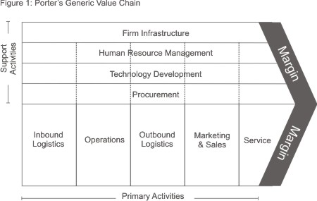

Slide 26
Primary activities
Inbound logistics:
processes that are involved in the receiving, storing, and internal distribution of the raw materials or basic ingredients of a product or service.
Bring raw material from source to the company.
The value chain can be enhanced in this step by improving the quality of raw material as well as optimizing the cost of inbound logistics.
Operations:
Converting the raw material to finished goods.
The customer value is increased majorly in this step if the operations are up to mark and the product is manufactured in the right manner and meets quality standards

Slide 27
Outbound logistics:
Sending finished goods from manufacturing point to distributors and retailers.
The value chain receives a boost if the out bound logistic activities are carried out in time with optimal costs and the product is delivered to end customers with minimum affect to the quality of the product.

Slide 28
Marketing and sales
The marketing and sales apply push as well as pull strategy to increase the sales of the product.
The company exists to make profits and if profits can be increased by marketing and sales, than the company has to use these tools.
Marketing needs to be done in the right manner to build brand equity and sales should be done in the proper channel without any false commitments given to customers to add value to the end product and the brand.

Slide 29
Service
The post sales service is the most important because it directly affects the word of mouth publicity of the product.
If the service is not upto mark, no one will buy the product and the brand will lose market share and may be taken out of the market eventually.
Thus service is very important in the Porter’s value chain.

Slide 30
Support Activities (Secondary Activities)
Procurement(purchasing): This is how the raw materials for the product are obtained.
This is what the organization does to get the resources it needs to operate. This includes finding vendors and negotiating best prices.
Technology development: Technology can be used across the board in the development of a product, including in the research and development stage, in how new products are developed and designed, and process automation.

Slide 31
Human resource management: These are the activities involved in hiring and maintaining the proper employees to help design, build and market the product.
Firm infrastructure: This refers to an organization's structure and its management, planning, accounting, finance and quality-control mechanisms.

Slide 32
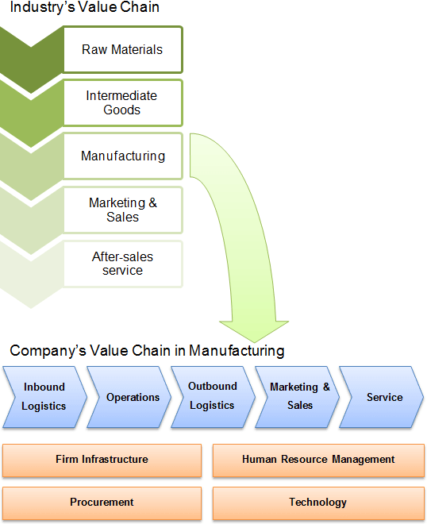

Slide 33
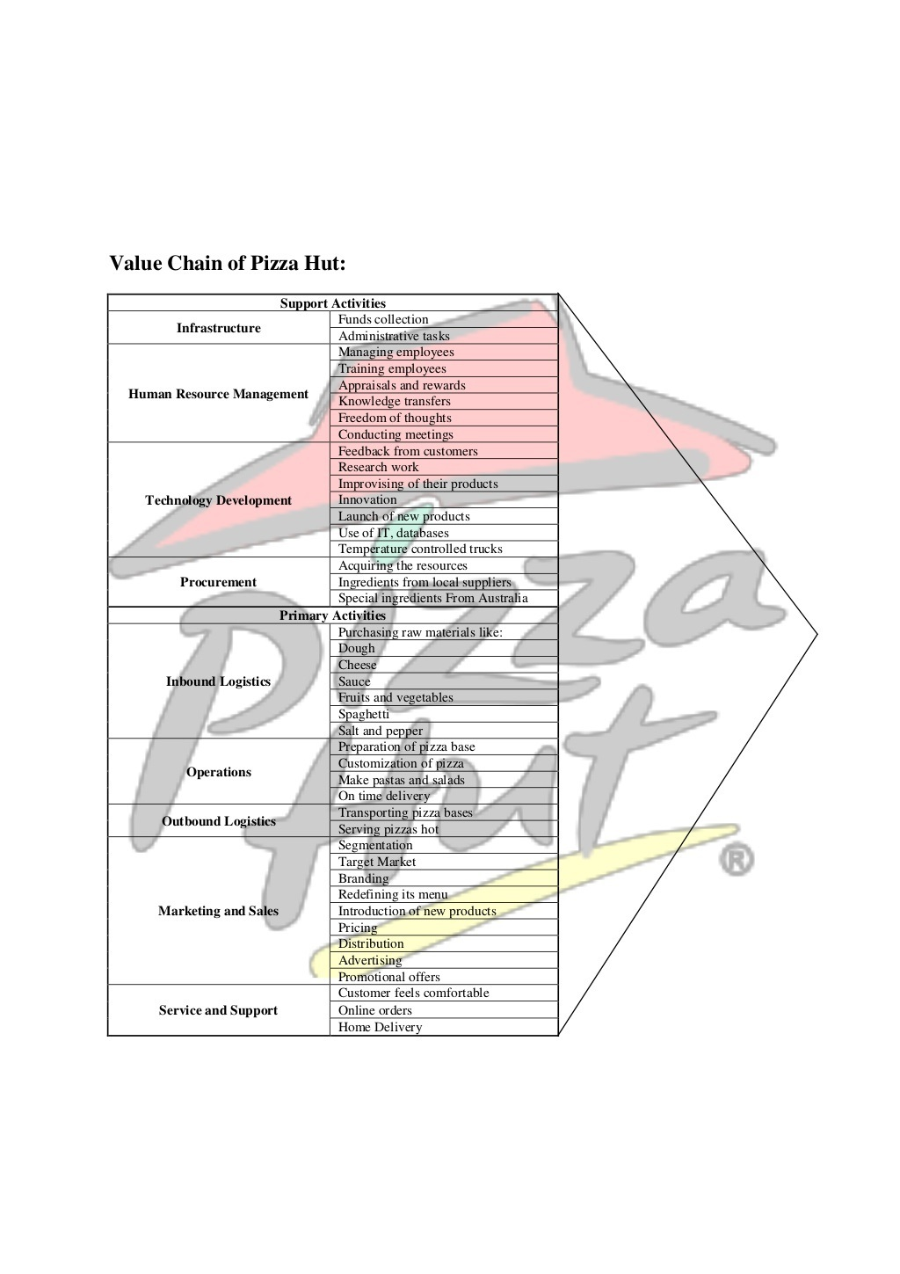

Slide 34
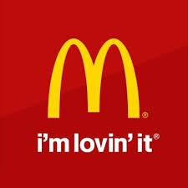
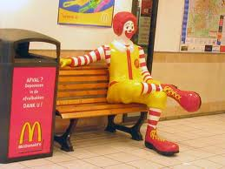
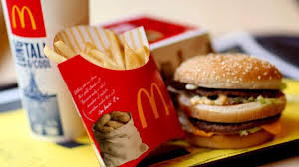
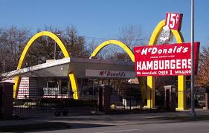
Value Chain Analysis in Mc Donald’s Corporation Ltd
Company Profile :
McDonald’s Corporation (NYSE: MCD) is the world’s largest chain of hamburger fast food restaurants, serving around 68 million customers daily in 119 countries. Headquartered in the United States.
A McDonald’s restaurant is operated by either a franchisee, an affiliate, or the corporation itself. The corporation’s revenues come from the rent, royalties and fees paid by the franchisees, as well as sales in company-operated restaurants. McDonald’s revenues grew 27 percent over the three years ending in 2007 to $22.8 billion, and 9 percent growth in operating income to $3.9 billion.
McDonald’s primarily sells hamburgers, cheeseburgers, chicken, french fries, breakfast items, soft drinks, milkshakes and desserts. In response to changing consumer tastes, the company has expanded its menu to include salads, wraps, smoothies and fruit.

Slide 35
Value Chain of McDonald’s( Michael Porter)
Primary Activities
1. Inbound Logistics
“McDonald’s purchases raw vegetables and other raw materials from its fixed, pre- defined suppliers only, therefore by increasing capital and labor, their production will increase proportionately.”
McDonald’s has practiced a backward vertical integration, by replacing most of its suppliers. It has done so for two reasons, 1) To reduce costs, and 2) To ensure that its products are of top quality. These suppliers include beef and milk to be used in its products, which it gets from its farms.
Other suppliers include local grocery stores that supply McDonald’s with fresh vegetables. Soft drinks are supplied exclusively by Coca-Cola, which is also its ally. McDonald’s supplies also include raw material such as flour, sugar, yeast,etc.”

Slide 36
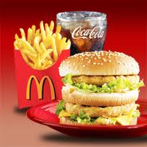
Value Chain of McDonald’s( Michael Porter)
2. Operations :
The McDonald’s Brothers changed the design of restaurant kitchen. Instead of having lots of different equipment and stations for preparing a wide of variety food, the Speedy kitchen had:
- A very large grill where one person could cook lots of burgers simultaneously
- A dressing station where people added the same condiments to every burgers
- A fryer where one person can made french fries
- A soda fountain and milkshake machine for desserts and beverages
- A counters where customers placed and received their orders.

Slide 37
Value Chain of McDonald’s( Michael Porter)
The Process
The mass-production process requires each restaurants chain to have a distribution network to carry the food to every restaurant. Warehouses store enormous amounts of everything a restaurant needs. Including foods, paper products and cleaning supplies. The warehouses the ship supplies to each restaurant by truck. Warehousing and distribution, just like the management of chain, is centralized rather than handled by each restaurant.
In other chains, it is automated, which means, a computer keeps track of what the restaurants have and should have on hand, or the distribution center ships the necessary items on a regular schedule instead of waiting a request from the restaurant.
This had been done with the view to increase efficiency of the supply chain in terms of capacity, technology selections, and buying policies.

Slide 38
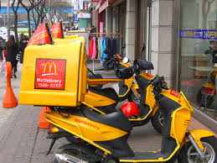
Value Chain of McDonald’s( Michael Porter)
3 Outbound Logistics
McDonald’s is committed to providing the highest quality food and superior service, at a great value, in a clean and welcoming environment. That’s why we work with our employees, franchisees, and suppliers to serve a balanced array of food choices and provide the nutrition information needed for customers to make sound decisions.
At the restaurant level, McDonald’s is focused on energy conservation, sustainable packaging, and waste management. We are dedicated to innovation and improving our operations in order to build an even more sustainable, environmentally friendly, and profitable business. And we will continue to reoptimize our menu, modernize the customer experience, and broaden accessibility to our brand, so that consumers will always enjoy the maximum McDonald’s experience.

Slide 39
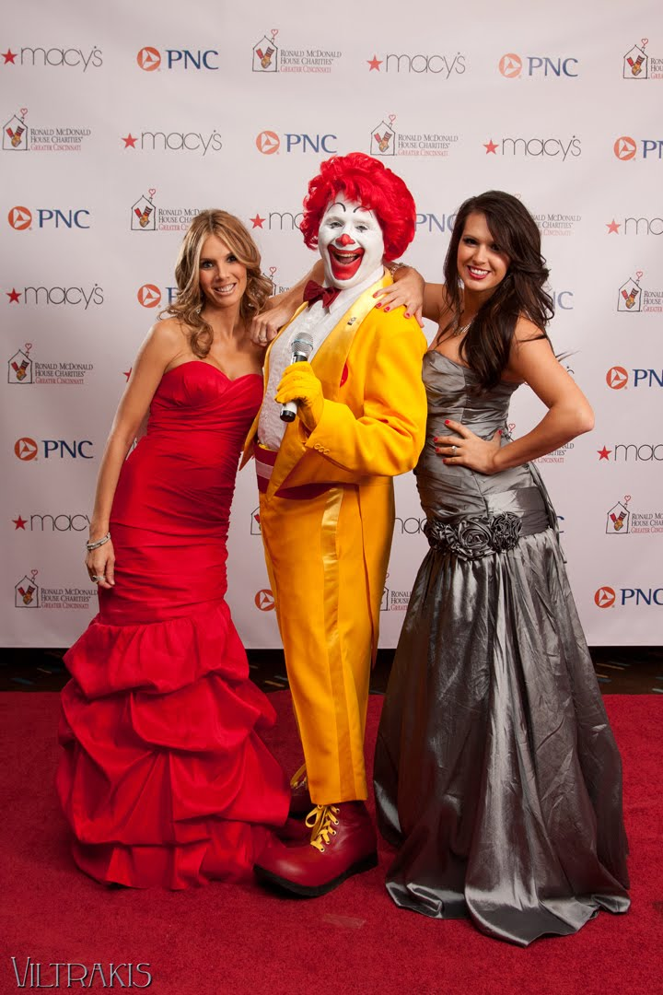
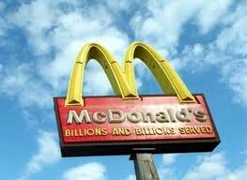
Value Chain of McDonald’s( Michael Porter)
4. Marketing and Sales
McDonald’s restaurants are found in 119 countries and territories around the world and serve 58 million customers each day. McDonald’s operates over 31,000 restaurants worldwide, employing more than 1.5 million people. The company also operates other restaurant brands, such as Piles Café.
McDonald’s has for decades maintained an extensive advertising campaign. In addition to the usual media (television, radio, and newspaper), the company makes significant use of billboards and signage, sponsors sporting events ranging from Little League to the Olympic Games, and makes coolers of orange drink with its logo available for local events of all kinds. Nonetheless, television has always played a central role in the company’s advertising strategy.

Slide 40
Value Chain of McDonald’s( Michael Porter)
5. Services
Free Wi-Fi @ McDonald’s
Your favorite McDonald’s meal now comes with complimentary Wi-Fi. Get some work done, check email, connect with friends…for free!
With free Wi-Fi at more than 11,500 participating restaurants, customers can access the Internet using their laptops or PDAs at no charge. So grab a McCafé Latte and log on…it’s on us! Just one more thing to love about McDonald’s.
Gift Card : Arch Card
The Arch Card is a pre-paid card that gives customers a quick and convenient way to pay at McDonald’s. Arch Cards also make the perfect gift for holidays or any special occasion. Arch Cards come in denominations of $5, $10, $25, and $50.
They can be purchased for the first time or reloaded later at participating McDonald’s restaurants nationwide. They are also available at retailers including Safeway, Kroger, SuperValu and Ahold.
McDonald’s Arch Cards never expire, and there are no penalty or dormancy fees.

Slide 41
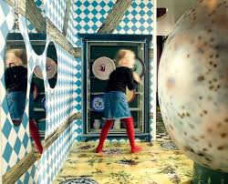

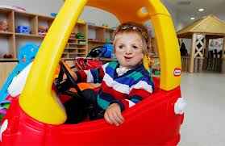
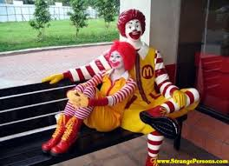
Value Chain of McDonal’s( Michael Porter)
PlayPlaces & Parties
You bring the kids, we’ll make the party. Super-fun for the kids, stress-free for you! We’ve got this party thing down to a science: Happy Meals, cake, decorations, party favors. Talk to your local McDonald’s manager to make arrangements.Depending on your location, you can have your child’s party at a McDonald’s PlayPlace for even more fun!

Slide 42
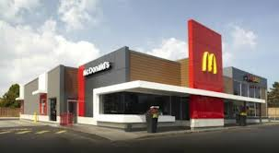
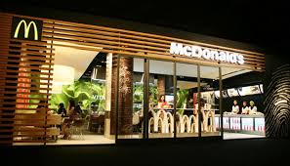
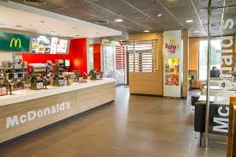
Value Chain of McDonald’s( Michael Porter)
Support Activities
1. Firm Infrastructure
McDonald’s Infrastructure is modern an sophisticated, they using the advanced IT and yet they’re still maintaining the green activities.
McDonald’s strives to provide eco-friendly workplaces and restaurants that reflect our sustainability goals and demonstrate environmental stewardship in the workplace.

Slide 43
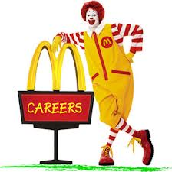
Value Chain of McDonald,s( Michael Porter)
2. Human Resource Management
The work offered by McDonald’s may have some positive elements, but workers are often choosing employment at McDonald’s in the context of having few other attractive options. Almost regardless of what people think of the work itself, working at McDonald’s could be said to offer advantages for some employees who want flexible hours and are engaged in other activities and responsibilities. For those marginalised in the labour market who have few chances of a job elsewhere, McDonald’s offers much needed work.

Slide 44
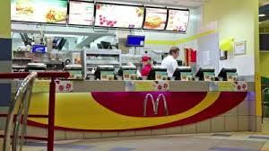
Value Chain of McDonald’s( Michael Porter)
3. Technology Development
McDonald’s will focus on modernizing restaurants, evolving the menu and engineering value.
McDonald’s enters five-year IT support deal with Fujitsu
The IT outsourcer will offer support for point-of-sale systems and back office operations to both company-owned and franchise outlets, replacing various incumbent suppliers.

Slide 45

Value Chain of McDonald’s( Michael Porter)
4. Procurement
McDonalds E-Procurement SystemMcDonalds E-Procurement System is basically a main reason for their successful supply chain management.It is so efficient that it provides the backbone not only to all the logistics but the whole McDonalds supply chain management.
It is a procurement hub launched in 2001 allow all of McDonald’s franchises across the globe to buy everything needed to run their restaurants. From uniform to HamBurger
Aside from being faster and more convenient for franchisees, the procurement site also allow business owners to buy supplies and materials at a discounted price, ultimately reducing costs for McDonald’s

Slide 46
Functional Strategy
It is the strategy or organizational plan adopted by each functional area, viz. marketing, production, finance, human resources and so on, in line with the overall business or corporate strategy, to achieve organizational level objectives.
The functional strategy of a company is customized to a specific industry or strategic business unit (SBU) and is used to back up other corporate and business strategies.
Each department develops certain objectives, which is to be enforced by employees, and aids in the achievement of final organizational goals.

Slide 47
What is Supply Chain Management ?
Supply chain management (SCM) is the active management of supply chain activities to maximize customer value and achieve a sustainable competitive advantage.
It represents a conscious effort by the supply chain firms to develop and run supply chains in the most effective & efficient ways possible.
Supply chain activities cover everything from product development, sourcing, production, and logistics, as well as the information systems needed to coordinate these activities.

Slide 48
Supply Chain Strategy
supply chain management -supply chain operations are controlled to reduce costs.
it defines how the supply chain should operate in order to compete.
Supply chain strategy is an iterative process that evaluates the cost benefit trade-offs of operational components.

Slide 49
ACHIEVING STRATEGIC FIT
All processes and functions that are part of a company's value chain contribute to its success or failure.
These processes and functions do not operate in isolation; no one process or function can ensure the chain's success.
Failure at any one process or function, however, may lead to failure of the overall chain.

Slide 50
A company's success or failure is closely linked with 3 keys:
The competitive strategy and all functional strategies must fit together to form a coordinated overall strategy. Each functional strategy must support other functional strategies and help a firm reach its competitive strategy goal.

Slide 51
2. The different functions in a company must appropriately structure their processes and resources to be able to execute these strategies successfully.
3. The design of the overall supply chain and the role of each stage must be aligned to support the supply chain strategy.

Slide 52
A company may fail either because of a lack of strategic fit or because its overall supply chain design, processes, and resources do not provide the capabilities to support the desired strategic fit.

Slide 53
HOW IS STRATEGIC FIT ACHIEVED?
A company need to do to achieve that all-important strategic fit between the supply chain and competitive strategies.
A competitive strategy will specify, either explicitly or implicitly, one or more customer segments that a company hopes to satisfy.
To achieve strategic fit, a company must ensure that its supply chain capabilities support its ability to satisfy the targeted customer segments.

Slide 54
three basic steps to achieving this strategic fit
Understanding the Customer and Supply Chain Uncertainty.
Understanding the Supply Chain Capabilities.
Achieving Strategic Fit

Slide 55
Understanding the Customer and Supply Chain Uncertainty
To understand the customer - a company must identify the needs of the customer segment being served.
Seven-Eleven Japan and a discounter such as Sam‘s Club (a part ofWal-Mart).

